Slide 1

DELE CA1 Part A
Name: Hong Zheng Jie Randal
Class: DAAA/FT/2B/21
Admin No: p2309248

Slide 2
Overview of the Workflow
1. Project Configuration
2. EDA & Preprocess Data
3. Model Training
4. Model Evaluation
Import libraries
Retrieve data
Image analysis
Class image distribution analysis
Remove duplicative data
Scale image pixel values to [0,1]
Convert to greyscale
Convert image size to 37x37 and 131x131
Build models with different layers, optimizers, regularization etc.
Ensure model is not overfitting/underfitting by using plot functions of accuracy and loss per epoch
Choose best model from the val loss and val accuracy
Test and score with test data
Model summary

Slide 3
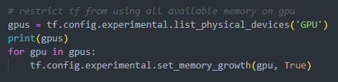

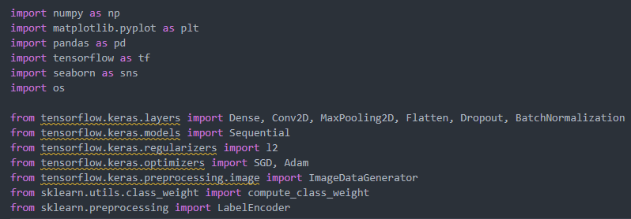
1. Project Configuration
Import all required modules
Ensure GPU is being used for model training
Set random seed for reproductibility

Slide 4
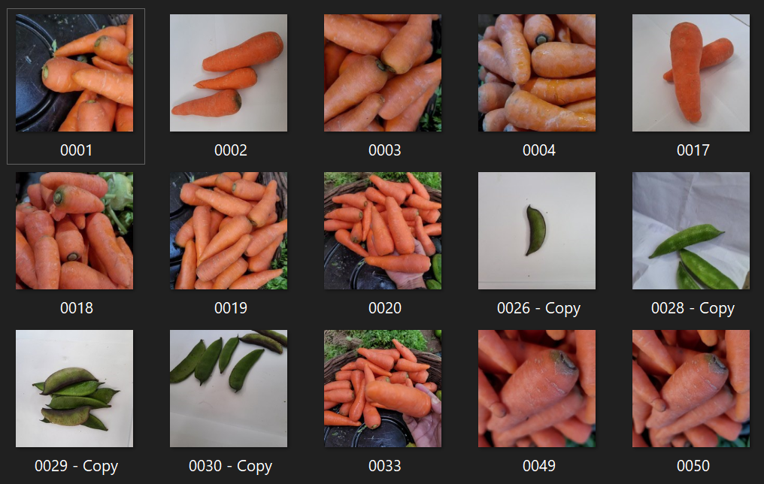
2. Exploratory Data Analysis – File Analysis
Noticed that images in training beans folder had images of carrots
Moved them into ‘wrongly classified images’
Did not put them into carrots folder as they already existed there
Moved images with ‘Copy’ in their filename

Slide 5
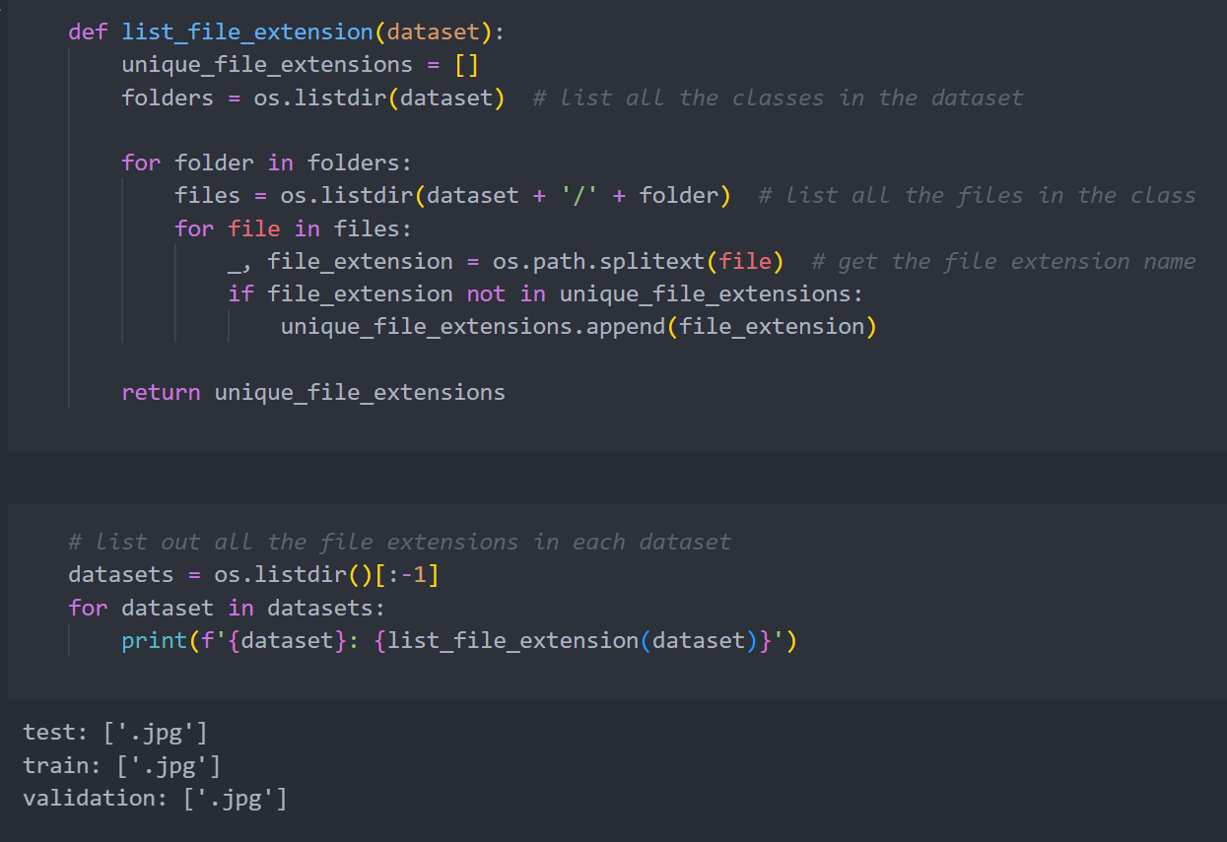
2. Exploratory Data Analysis – File Analysis
Analyse file extensions of images
All images in every dataset only had .jpg extensions

Slide 6
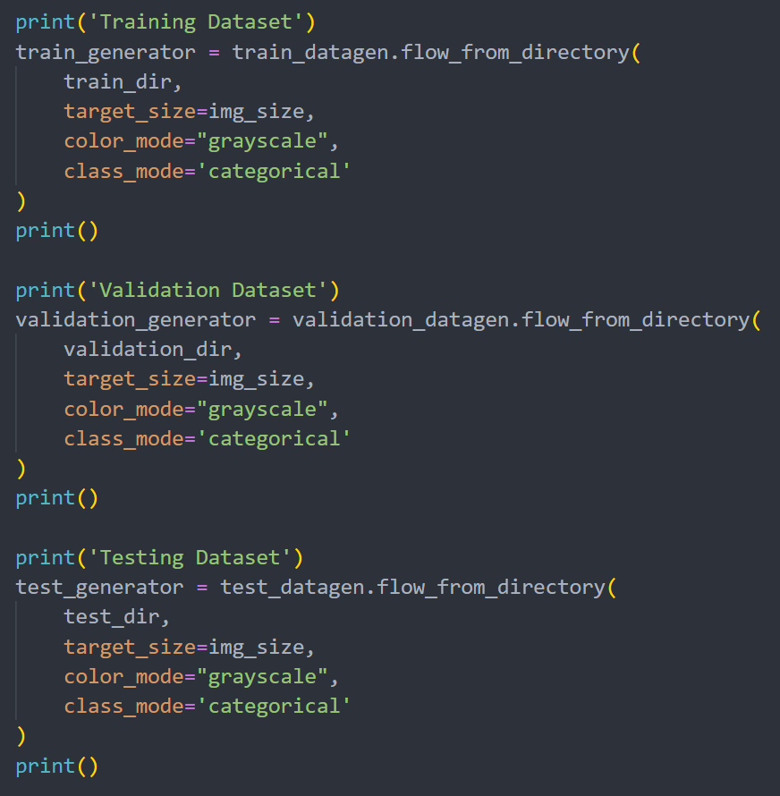
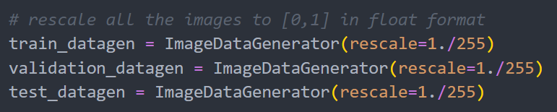
2. Exploratory Data Analysis – Image Analysis
Rescale image pixel values to [0,1]
Load data from each dataset (train, validation, test)

Slide 7
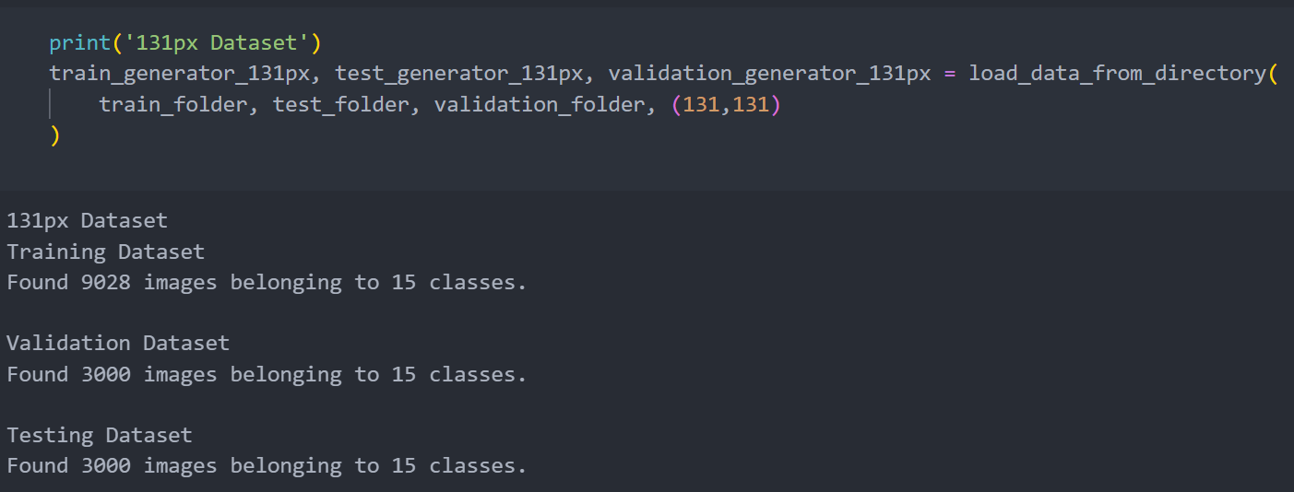
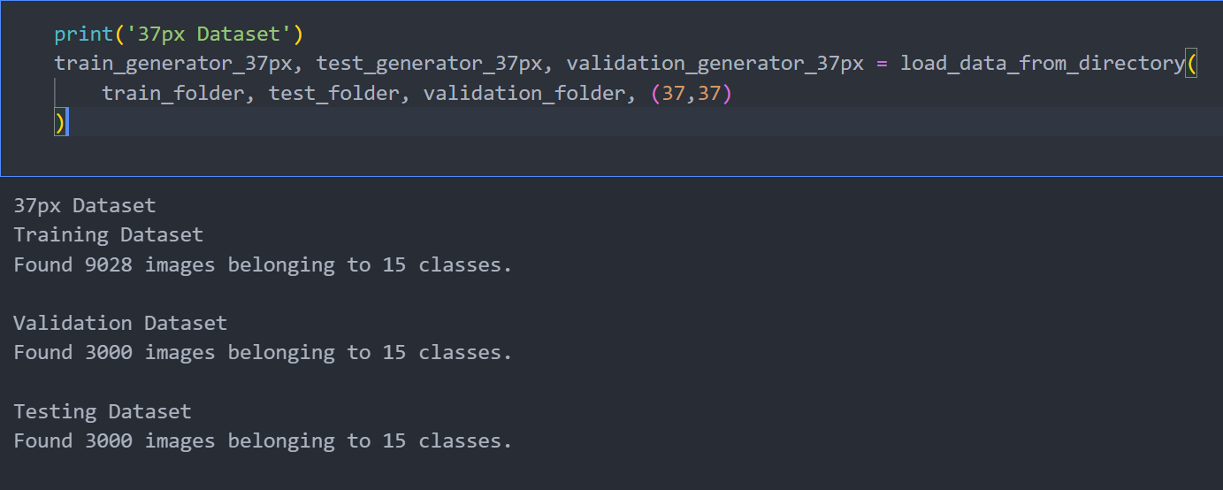
2. Exploratory Data Analysis – Image Analysis
Load datasets for each image size (37x37 and 131x131) and each dataset

Slide 8
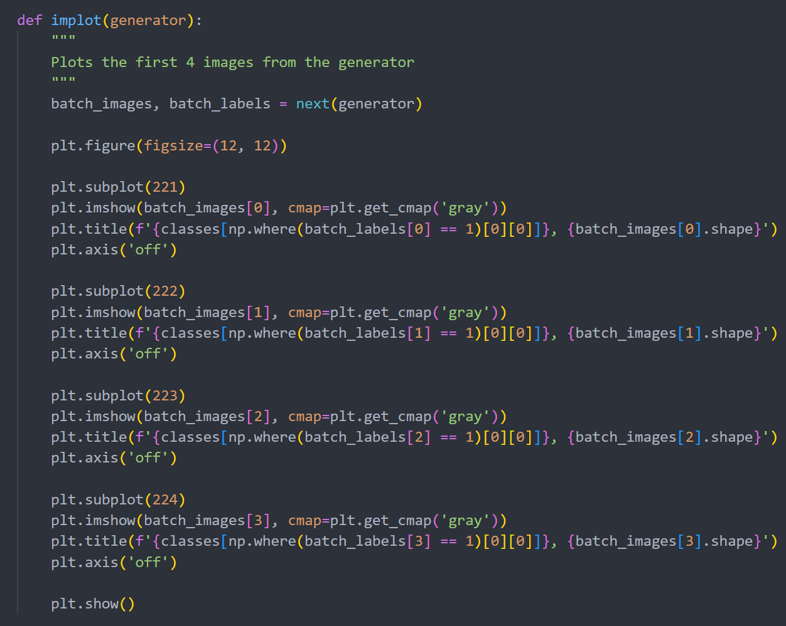
2. Exploratory Data Analysis – Image Analysis
Plot first 4 images from each dataset
Check if greyscaled and correct resolution

Slide 9
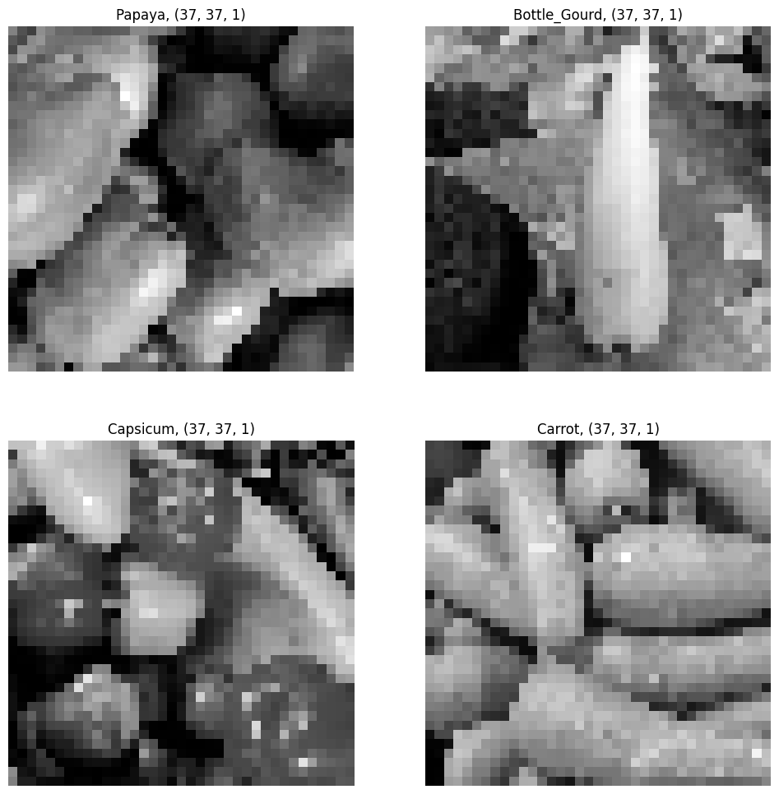
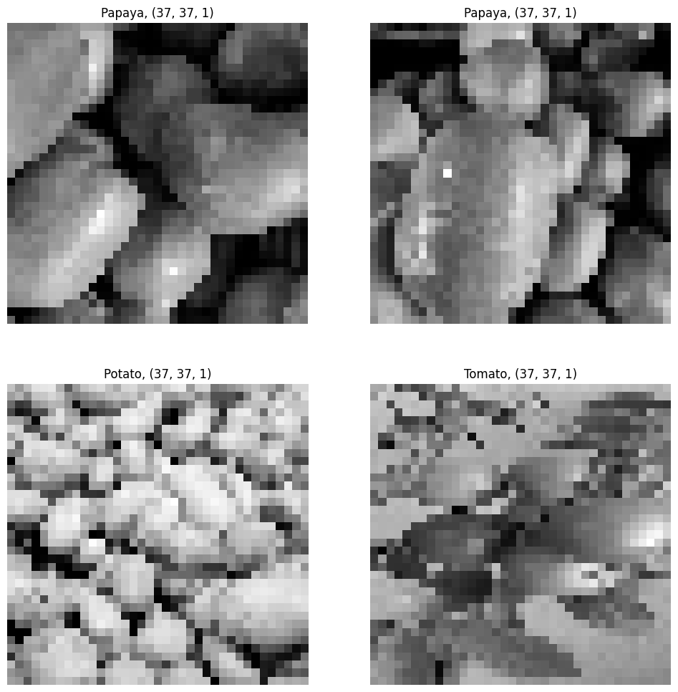
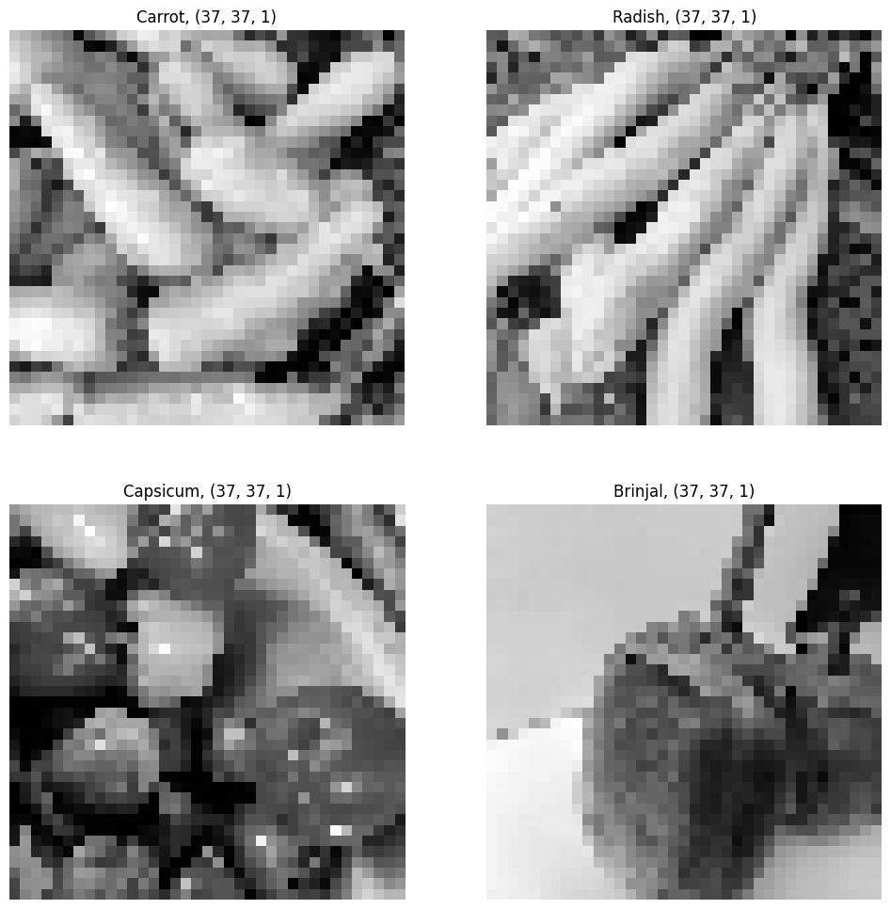
37px Datasets
Training
Validation
Testing

Slide 10
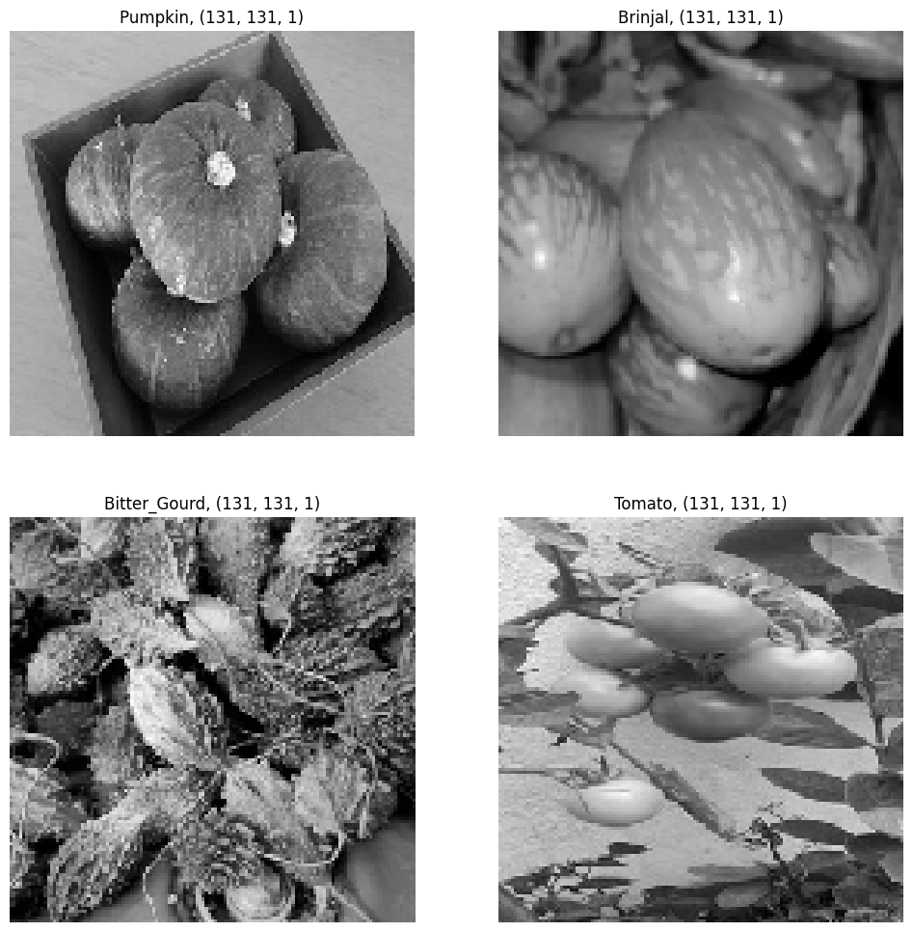
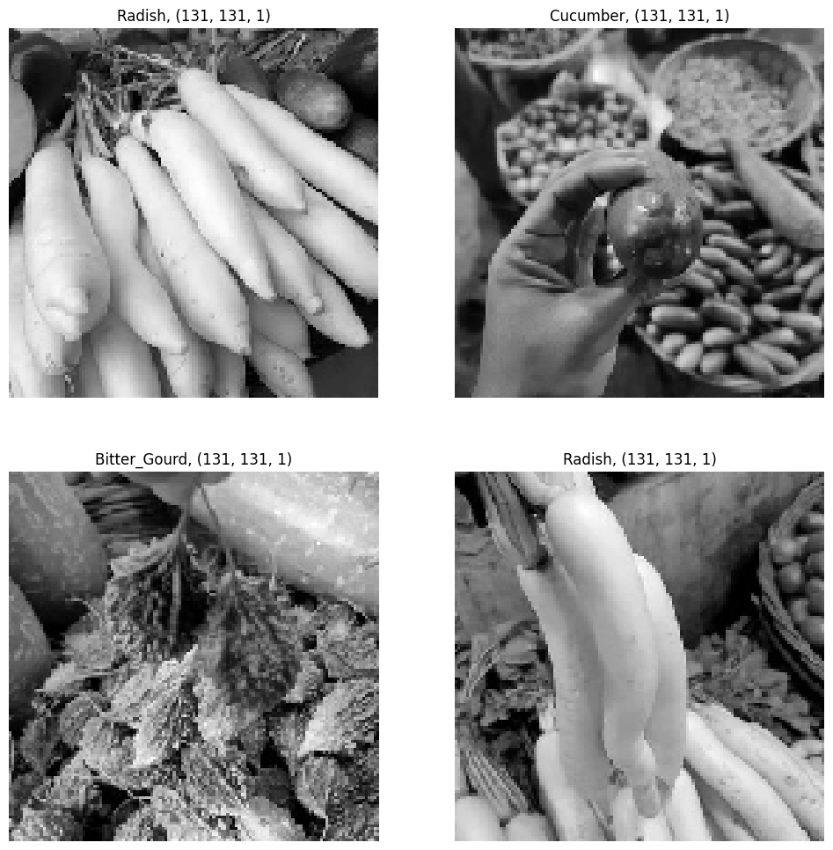
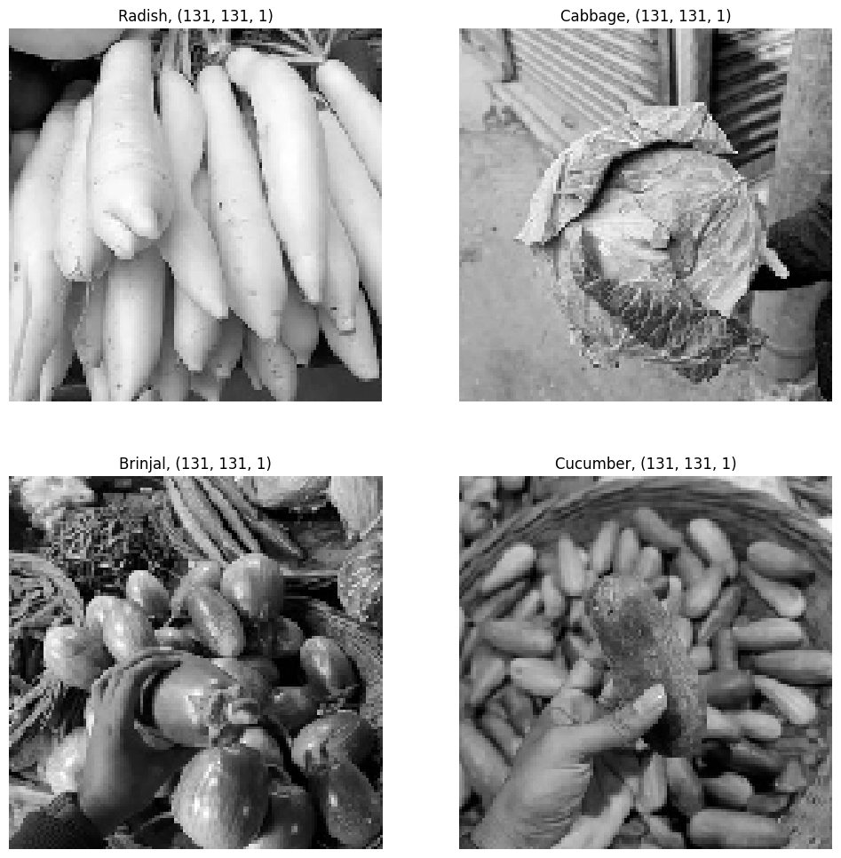
131px Datasets
Training
Validation
Testing

Slide 11
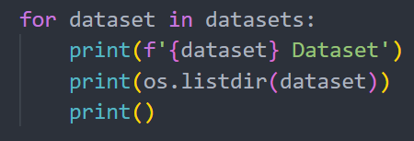
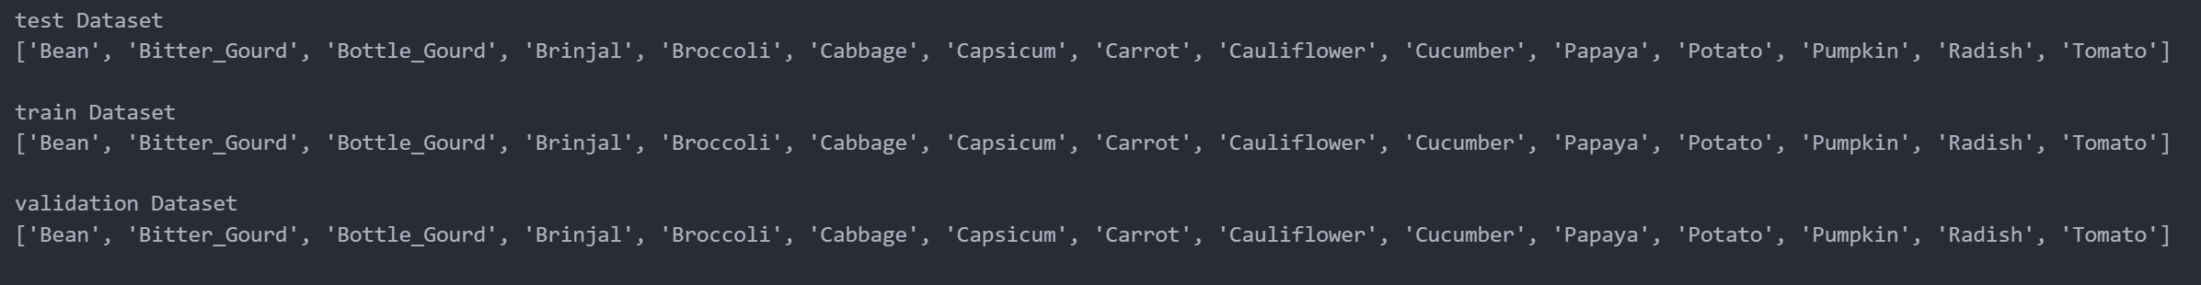
2. Exploratory Data Analysis – Class Analysis
Analyse classes in dataset
No class imbalance in dataset

Slide 12
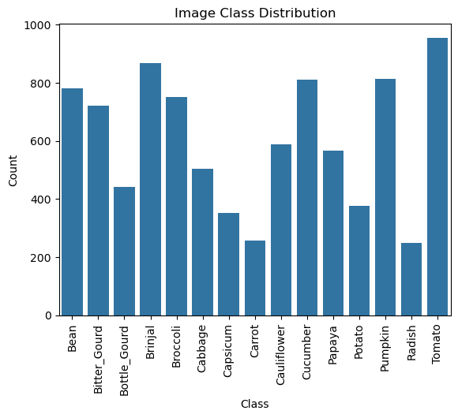
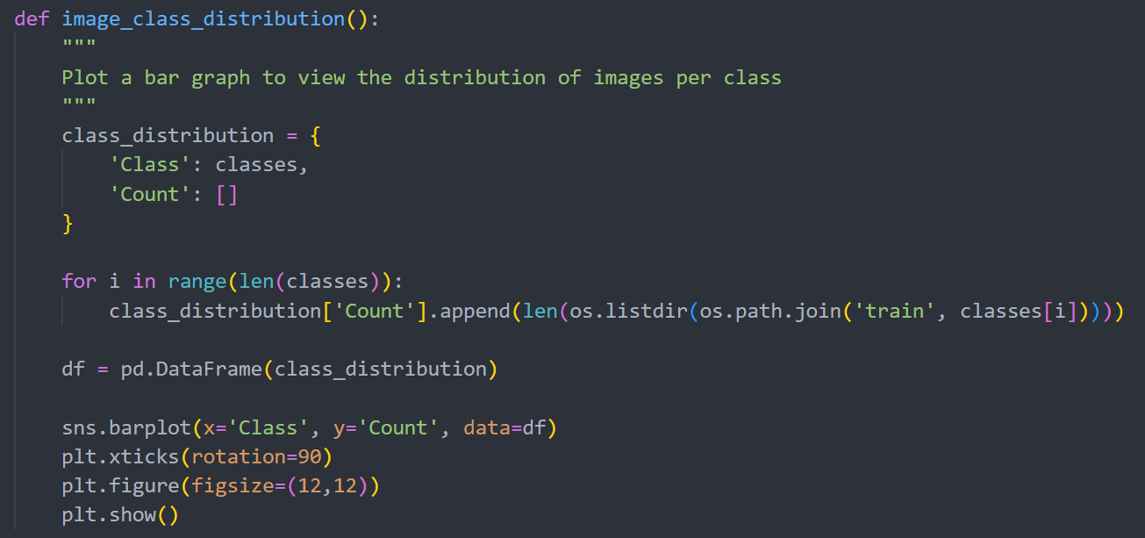
2. Exploratory Data Analysis – Class Analysis
View distribution of images by class in training dataset
Clear imbalance in distribution of images
Classes like Radish and Carrot have only about 300 images
Classes like Tomato have as much as 900

Slide 13
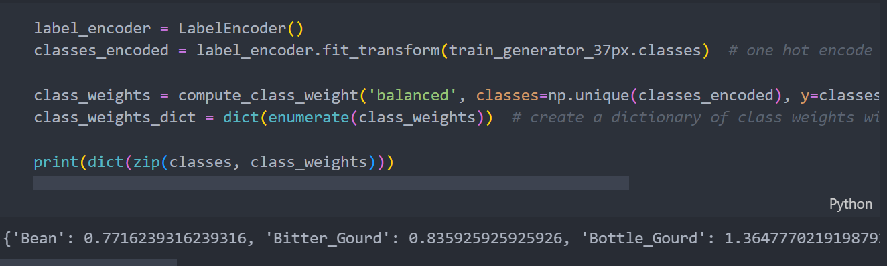
2. Exploratory Data Analysis – Class Analysis
Imbalance in images per class may affect model’s performance
We can use class weights to balance out the effect
Model will not be biased towards a certain class

Slide 14
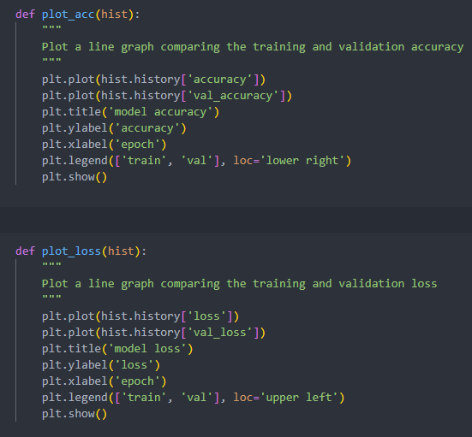
3. Model Training
We will be plotting the accuracy and loss plot many times to view our model’s performance
Create a function to reduce redundancy

Slide 15
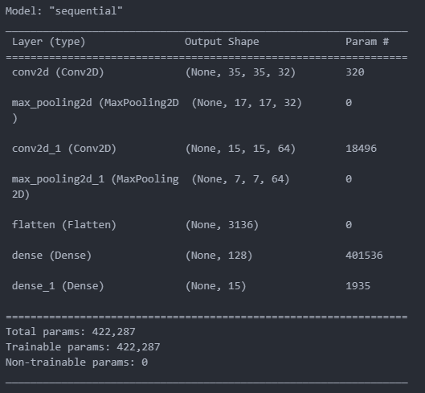
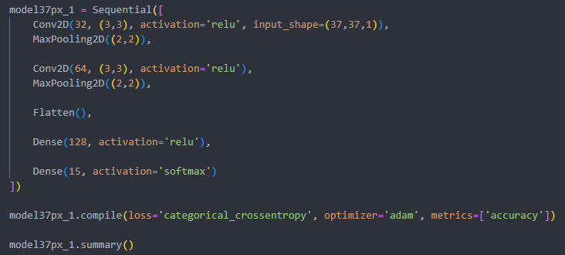
3. Model Training – 37px
As our first model, we will not add too many layers

Slide 16
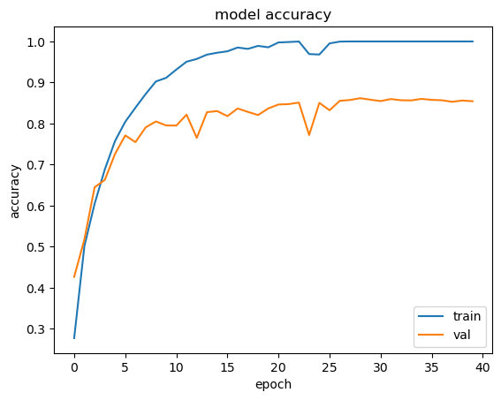
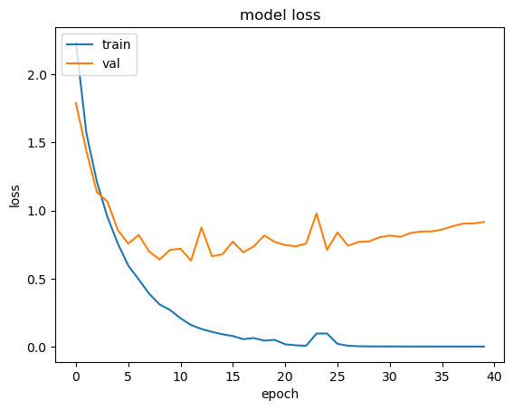
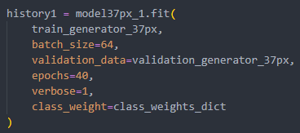
3. Model Training – 37px
Val loss is increasing
Val accuracy plateau
Add more layers as model is not very complex yet

Slide 17
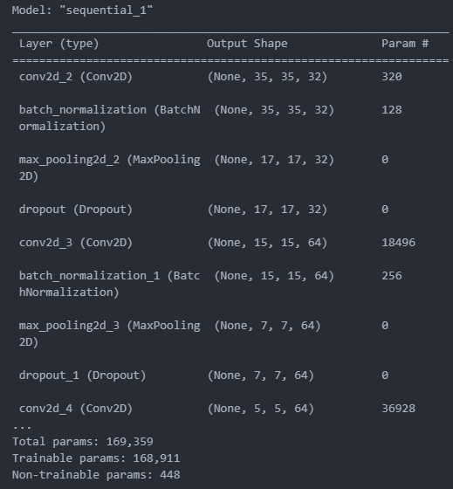
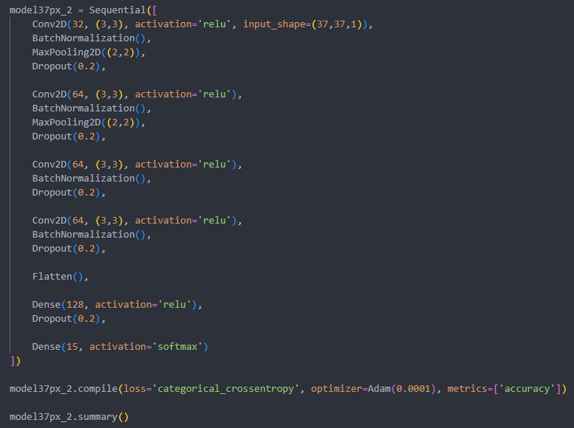
3. Model Training – 37px
Added BatchNormalization() and Dropout()

Slide 18
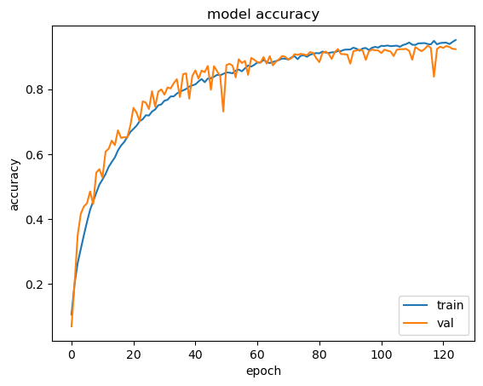
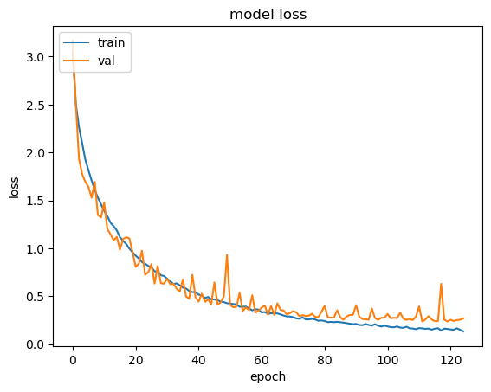
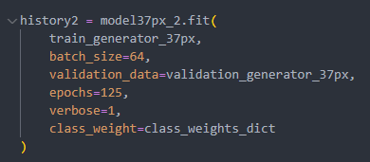
3. Model Training – 37px
High val accuracy
Low val loss
No signs of overfitting

Slide 19
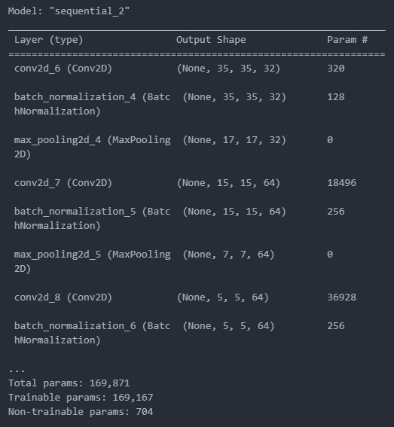
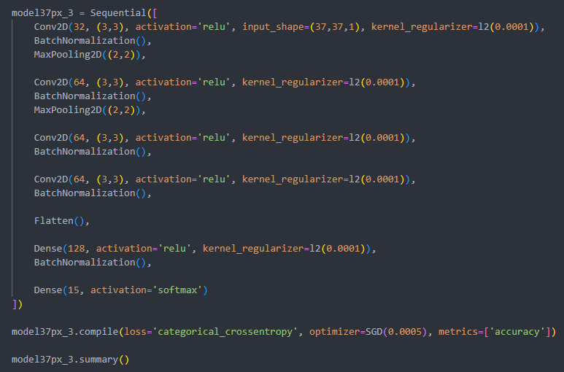
3. Model Training – 37px
Add L2 Regularization
Change optimizer from Adam to SGD and learning rate

Slide 20
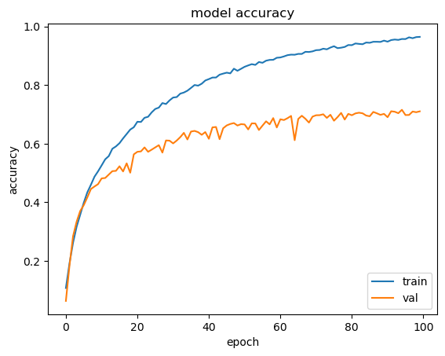
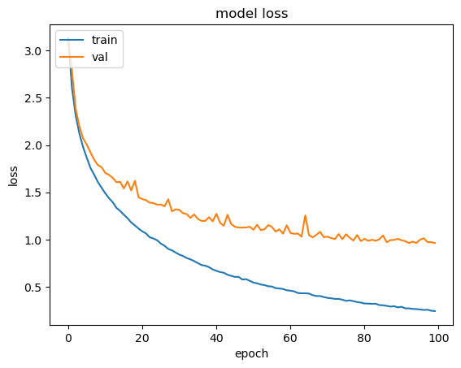
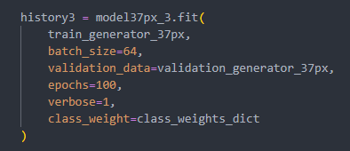
3. Model Training – 37px
Model does not perform as well using SGD with a learning rate of 0.0005 and L2 kernel regularizer
Val metrics are not as good as the previous model
No signs of overfitting
Val metrics plateauing

Slide 21
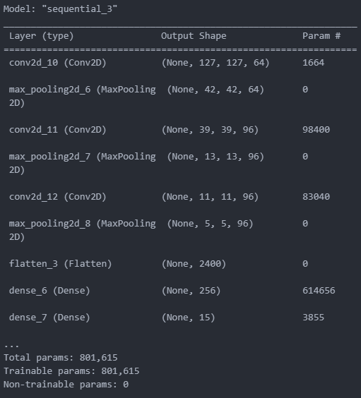
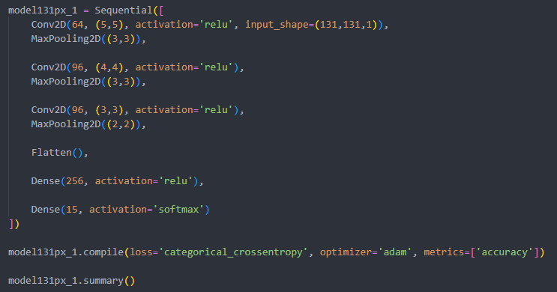
3. Model Training – 131px
As this will be our first model, we will not make the model too complicated with too many layers

Slide 22
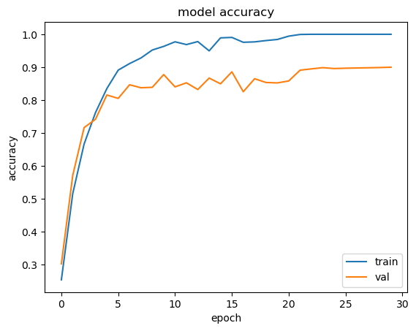
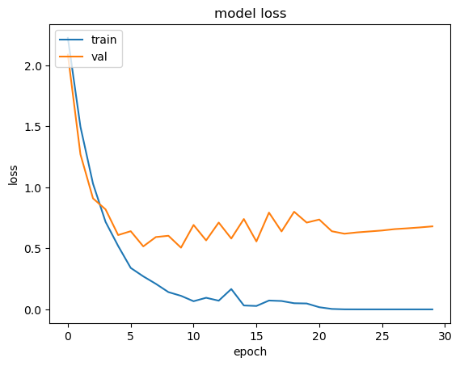
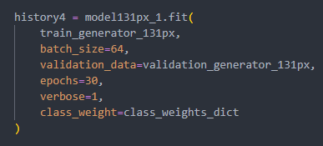
3. Model Training – 131px
Val accuracy is quite high
Model is not too complex yet
Higher dimension of inputs
We will still try to add more layers to see if the model can perform better

Slide 23
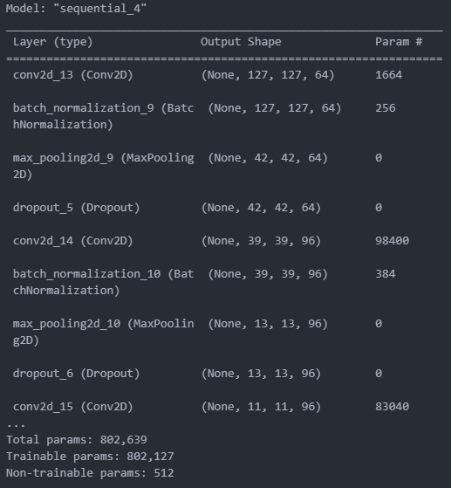
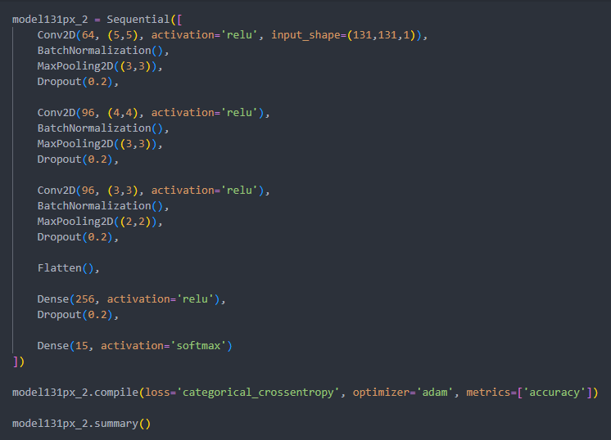
3. Model Training – 131px
Add BatchNormalization() and Dropout()

Slide 24
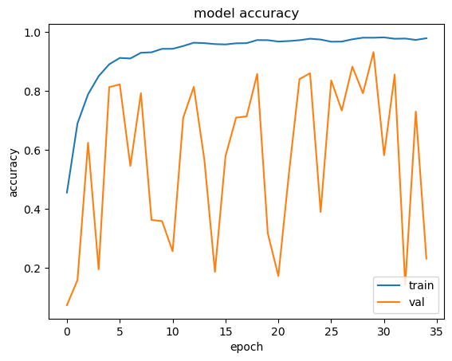
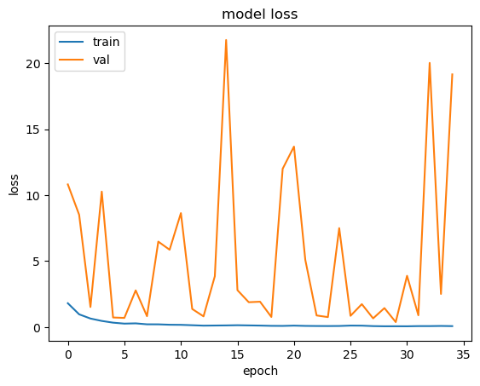
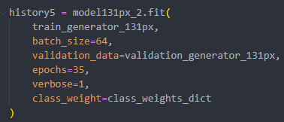
3. Model Training – 131px
Val metrics is very unstable
A lot of big jumps in the val metrics
Val loss is very high
Lower the optimizer learning rate so model is not too unstable

Slide 25
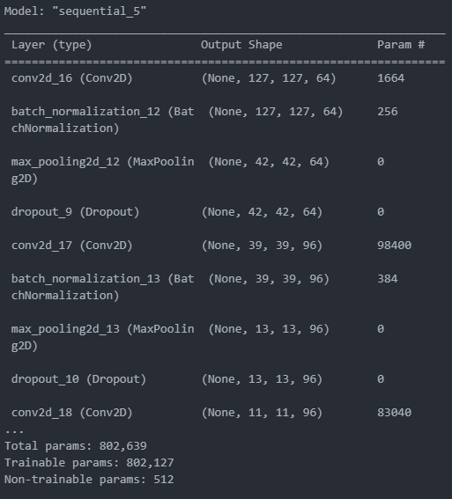
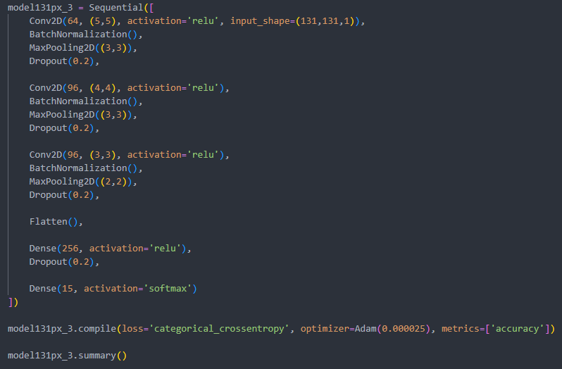
3. Model Training – 131px
Change optimizer rate
Not using SGD as previous model results were not good

Slide 26
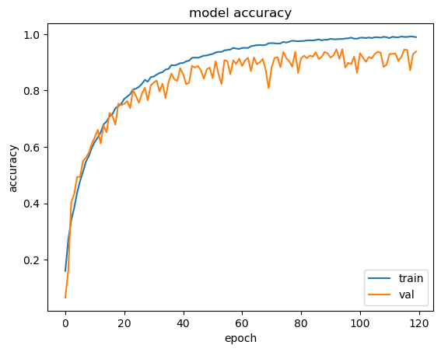
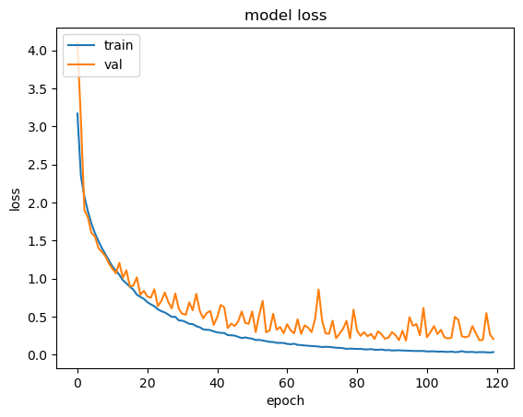

3. Model Training – 131px
Still small fluctuations in the val metrics
Model is not as unstable as before
Val metrics are also better than the previous model
No signs of overfitting too
Val metrics are not diverging away from the training metrics and remain relatively close to each other

Slide 27

4. Model Evaluation
Model 2 for 37px
Accuracy: 91.6%
Loss: 0.30

Slide 28

4. Model Evaluation
Model 3 for 131px
Accuracy: 93.8%
Loss: 0.22

